Slide 1

Project AngularJS Consuming RESTfull API Data.
Submitted By
Sunzida Nasrin
Trainee Id: 1230074
Batch Id: Esad-j2ee/pttc-m/33/01
Submitted To
Md. Moshaidul Islam
Consultant – ESAD-J2EE IDB-BISEW

Slide 2
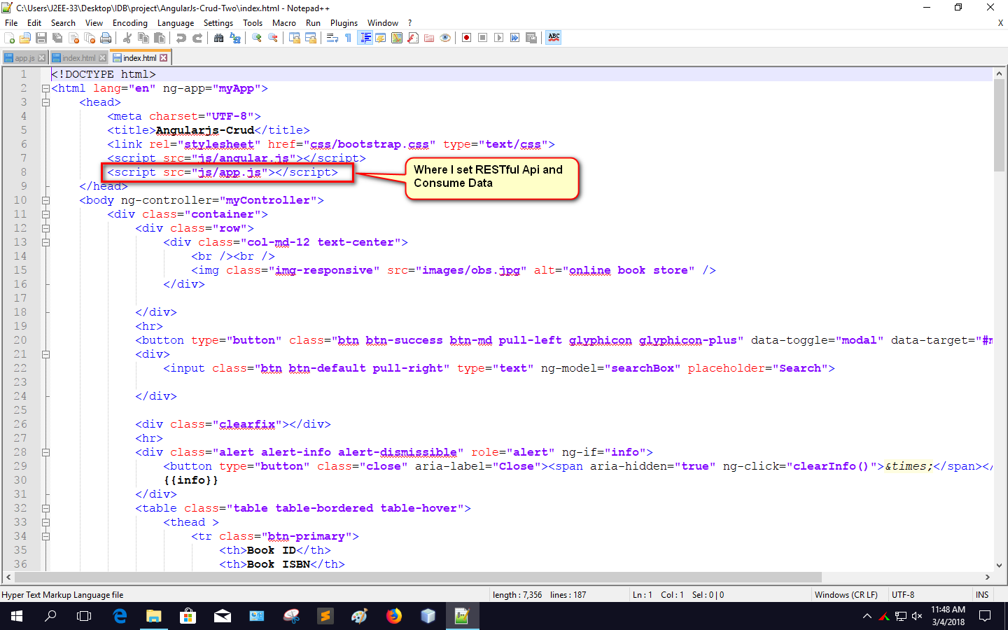

Slide 3
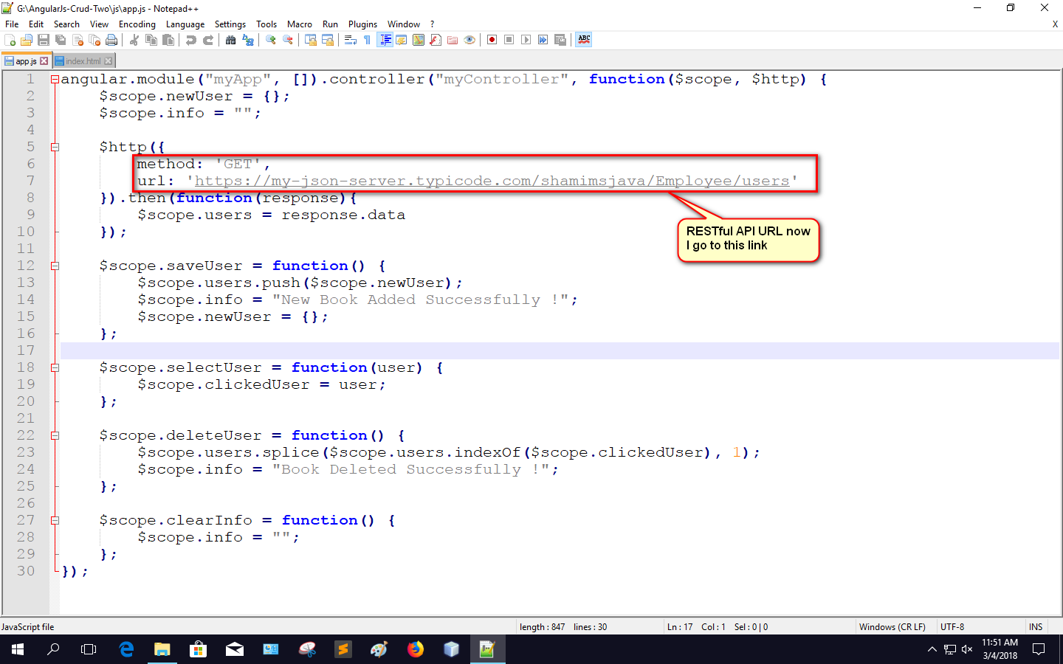

Slide 4
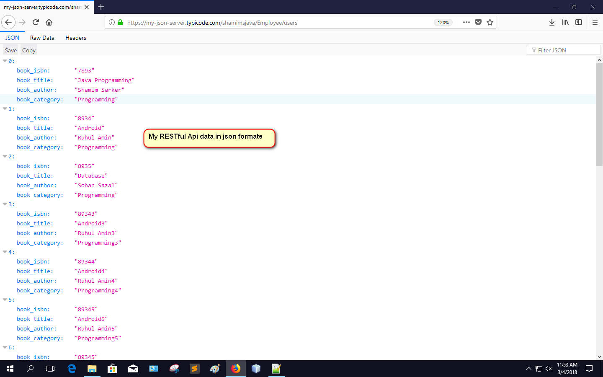

Slide 5
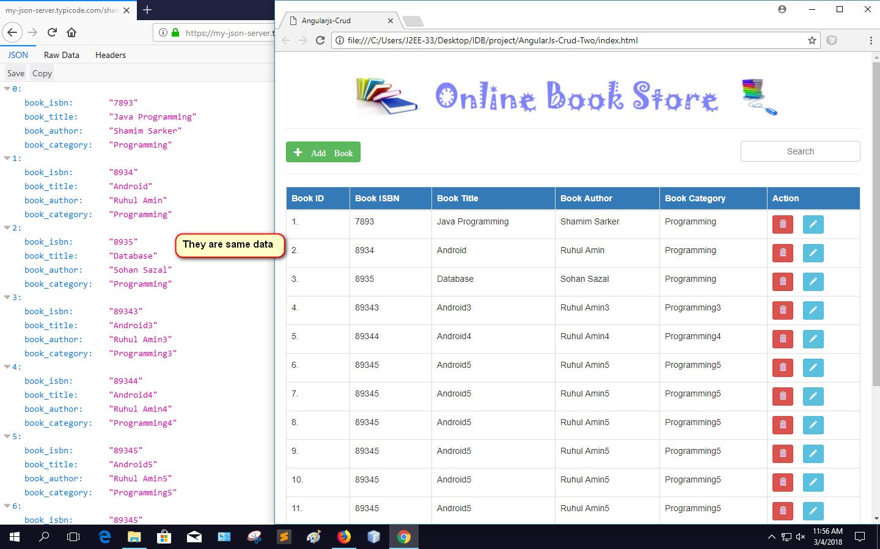

Slide 6
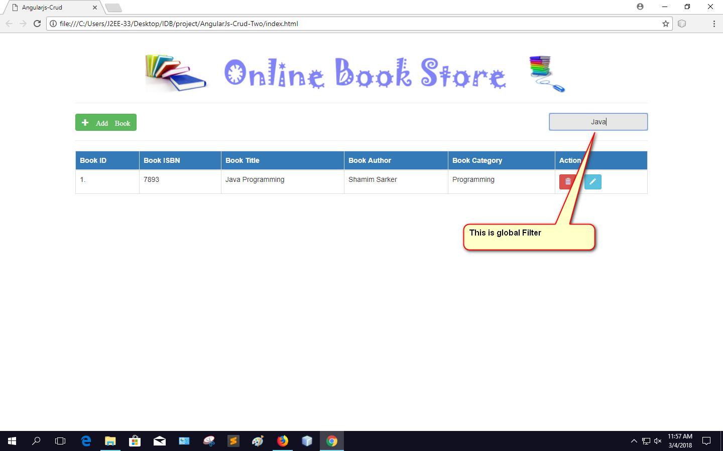

Slide 7
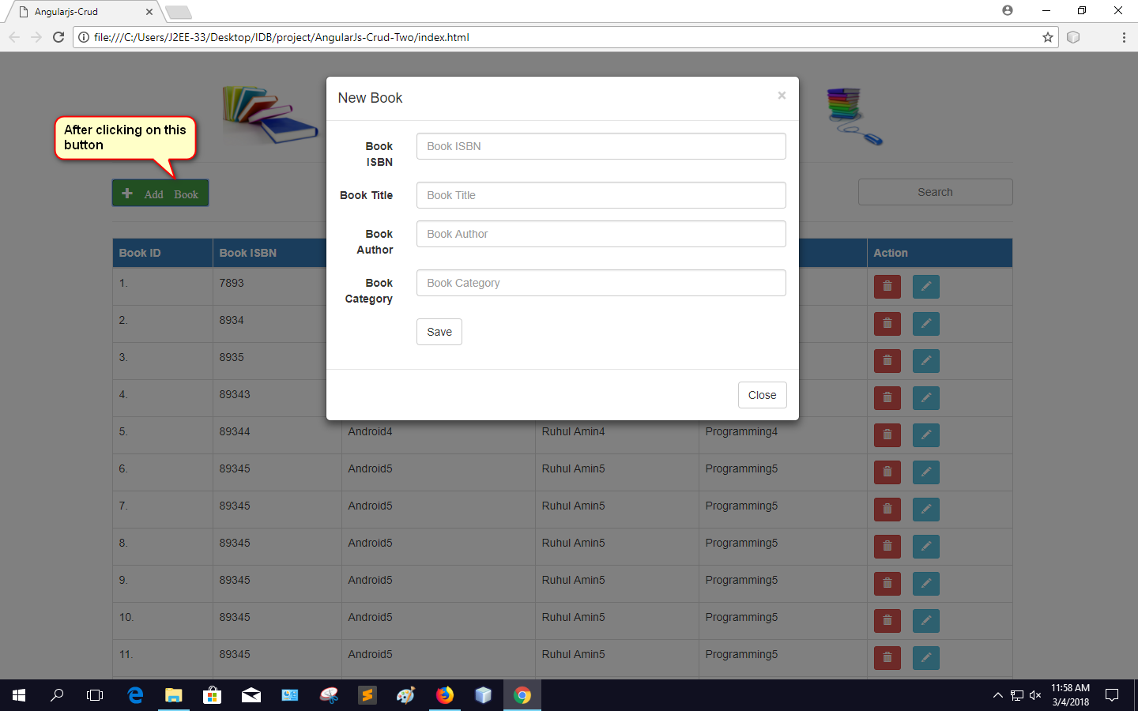

Slide 8
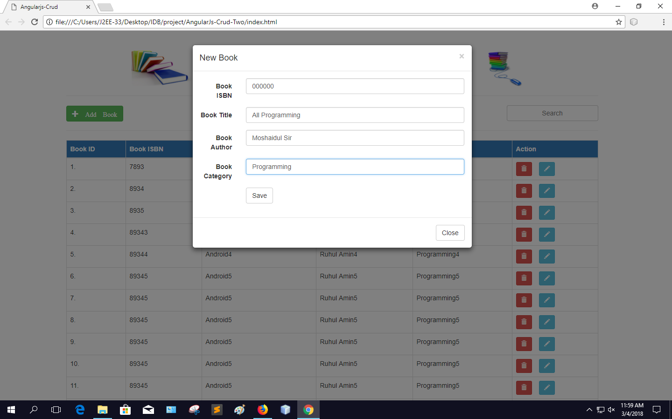

Slide 9
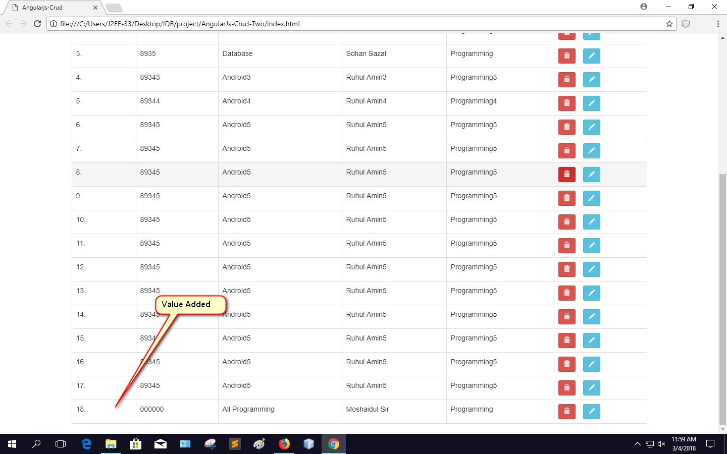

Slide 10
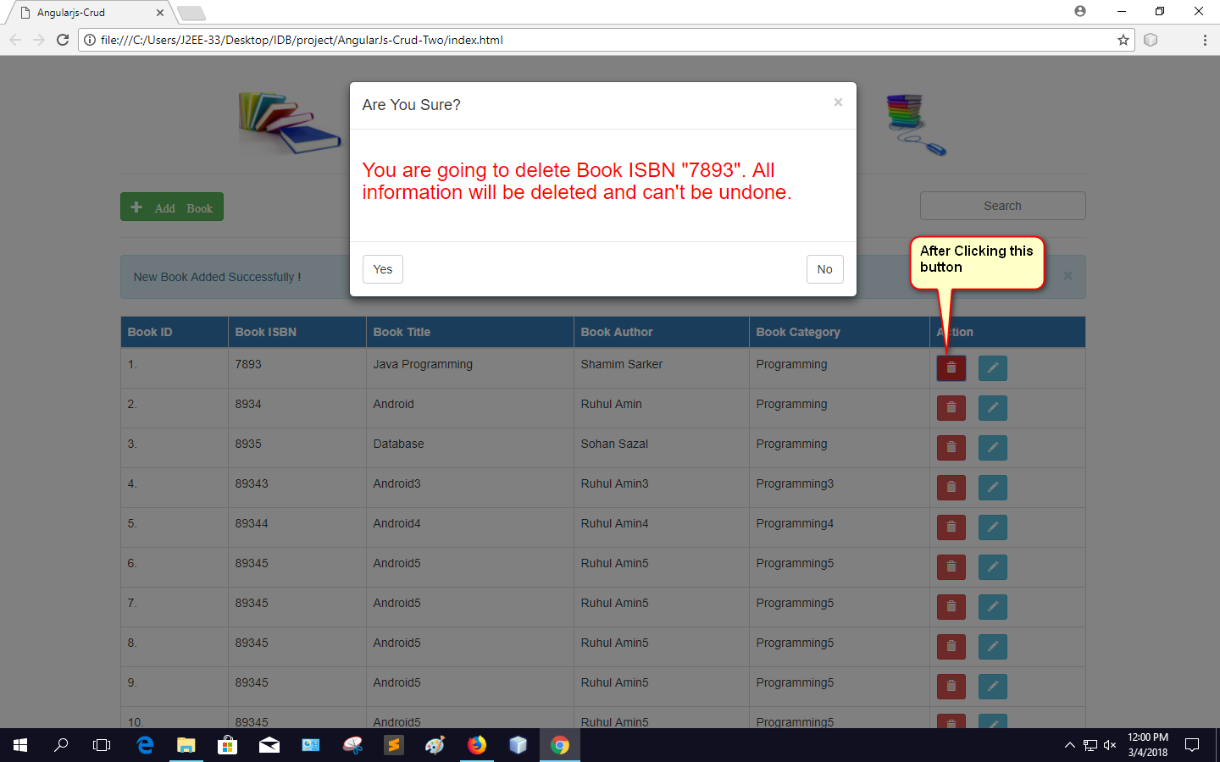

Slide 11
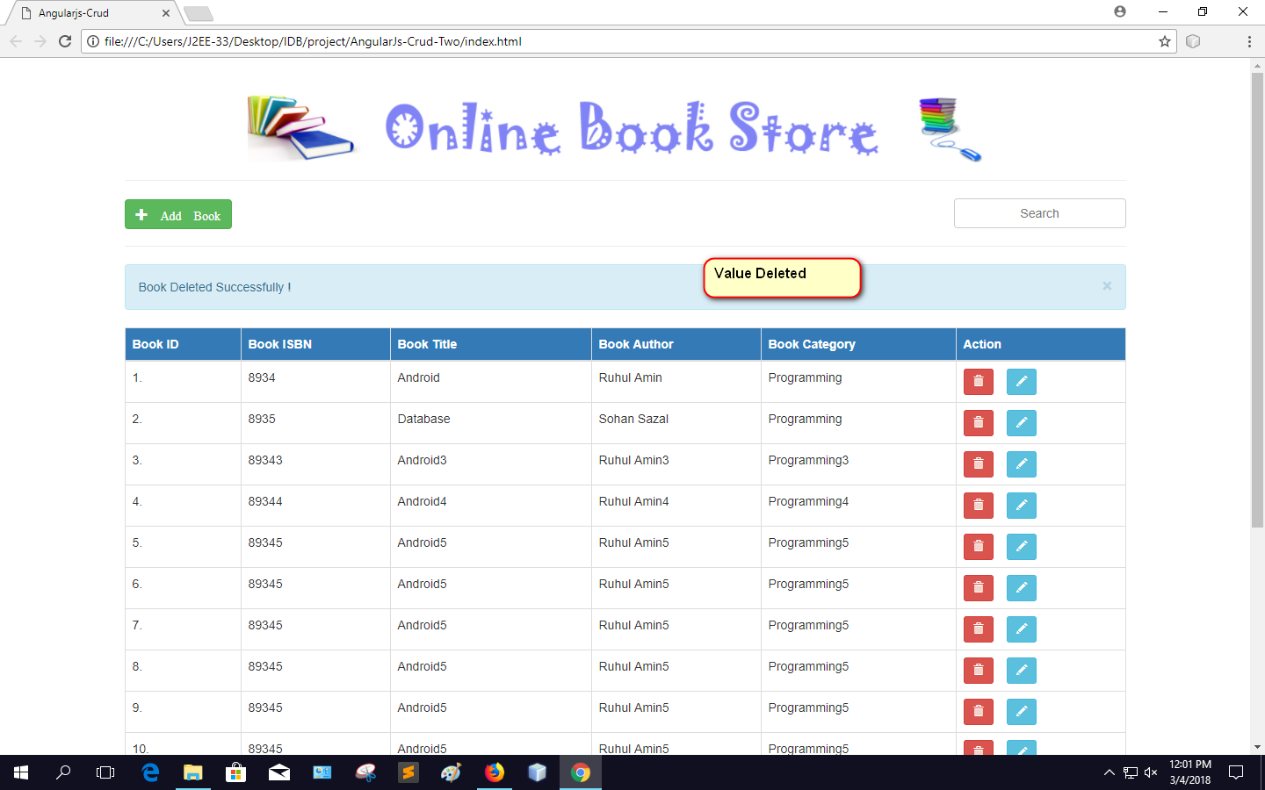

Slide 12
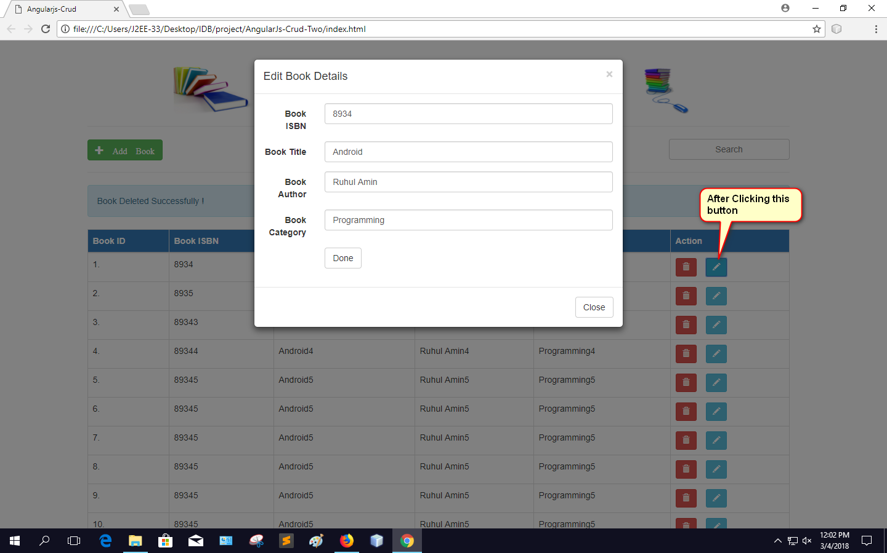

Slide 13
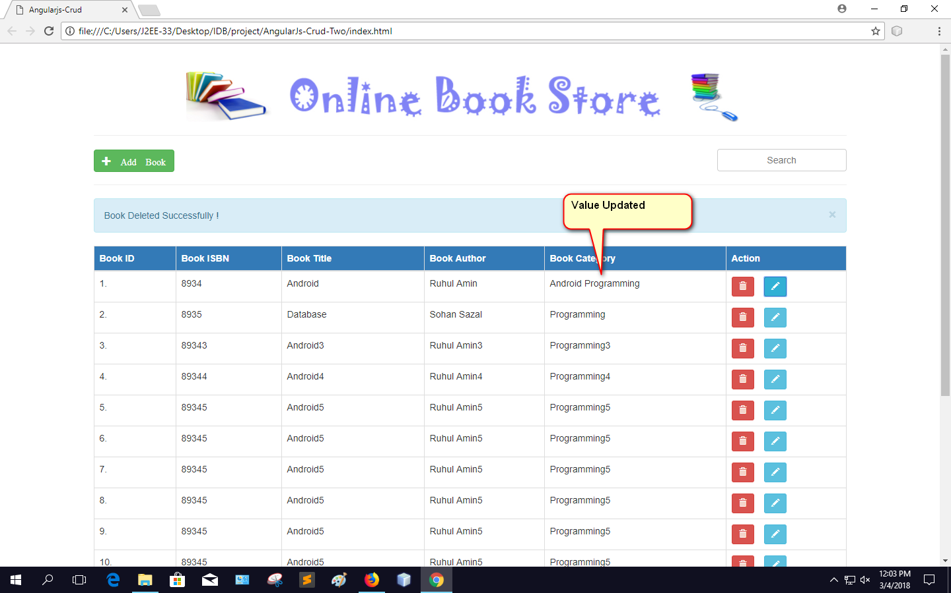

Slide 14
Thank You Sir

